Slide 1
Android Audio Subsystem
Overview and Architecture
SreeKumar

Slide 2
Contents
Introduction
Audio Architecture
Data flow Diagram
Android Audio Evolution
M to N
Linux Kernel Audio (ALSA)
Overview of ALSA SoCTI
Blaze and Tablet2

Slide 3
Android Audio Architecture

Slide 4
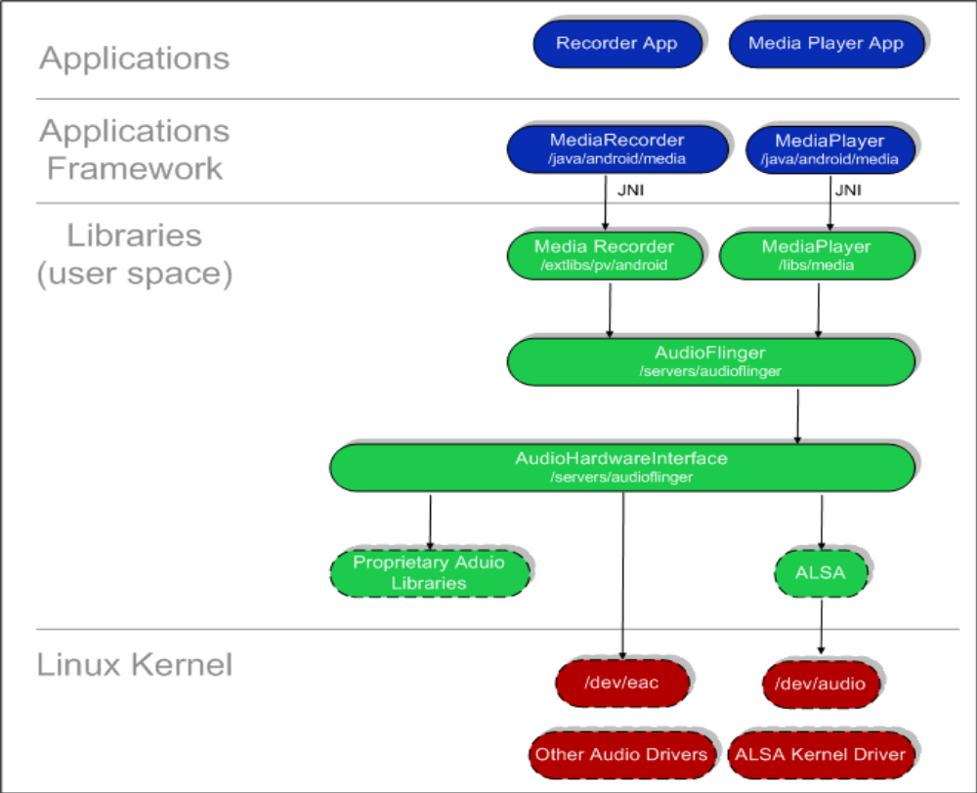
Android Audio Architecture

Slide 5
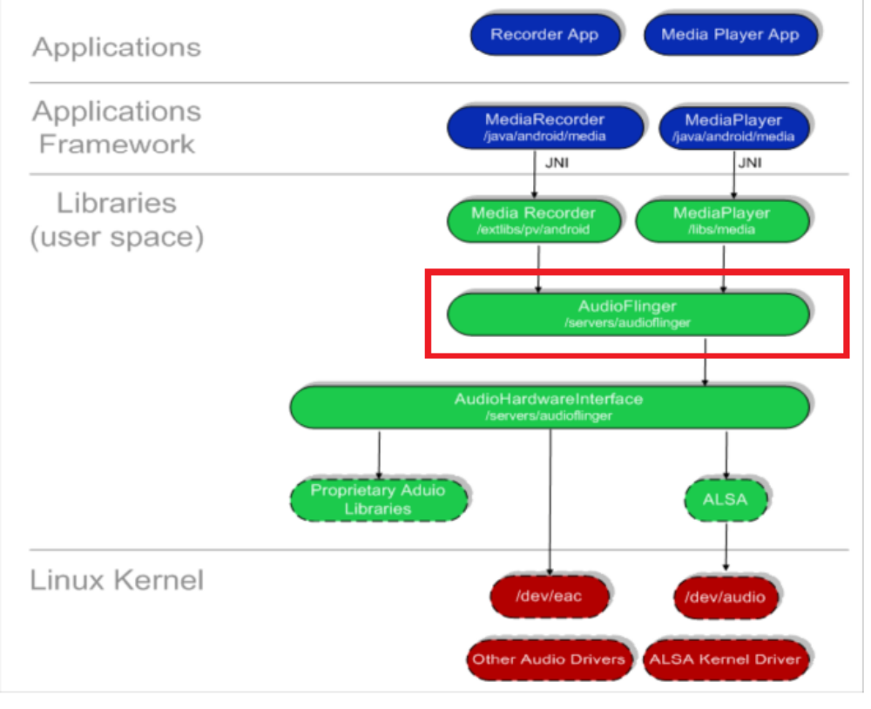
Audio Flinger

Slide 6
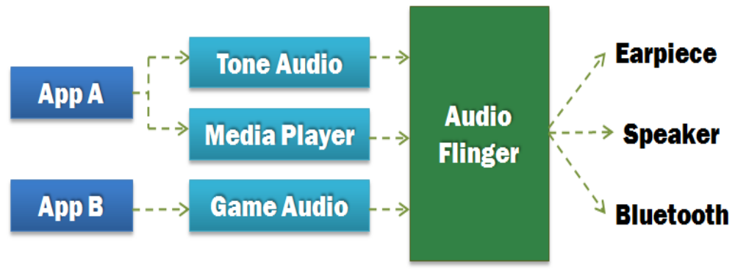
Audio Flinger
•Processes multiple input streams into a single PCM audio output stream
•Performs Mixing and Sample Rate conversion
–Output is usually fixed at 44100 samples per second
•Has direct output for Bluetooth. Everything else follows a standard audio path

Slide 7
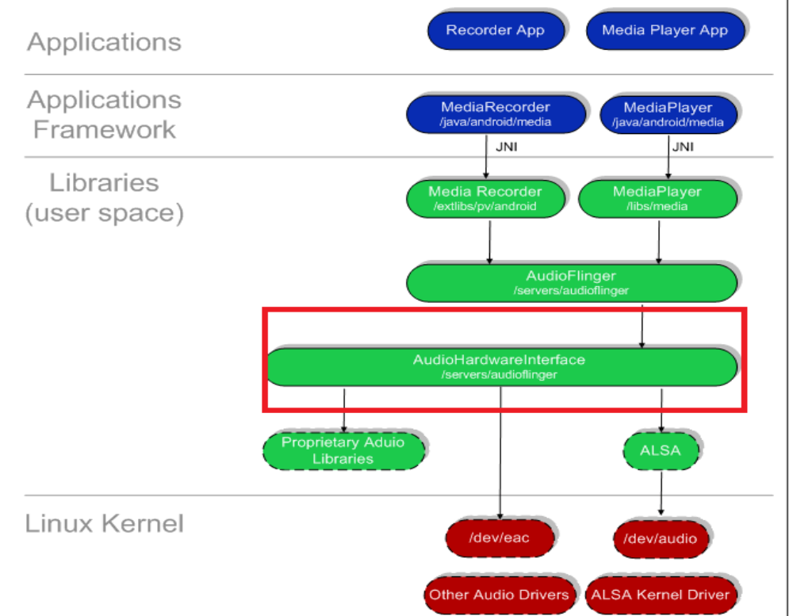
Audio HAL

Slide 8
Android Audio HAL
•Hardware Abstraction Layer
•Provides uniform interface between AudioFlingerand audio hardware (ALSA in our case)
•Volume adjustments, for example, go through the Audio HAL
•Implement audio routing based on Audio Usecase

Slide 9
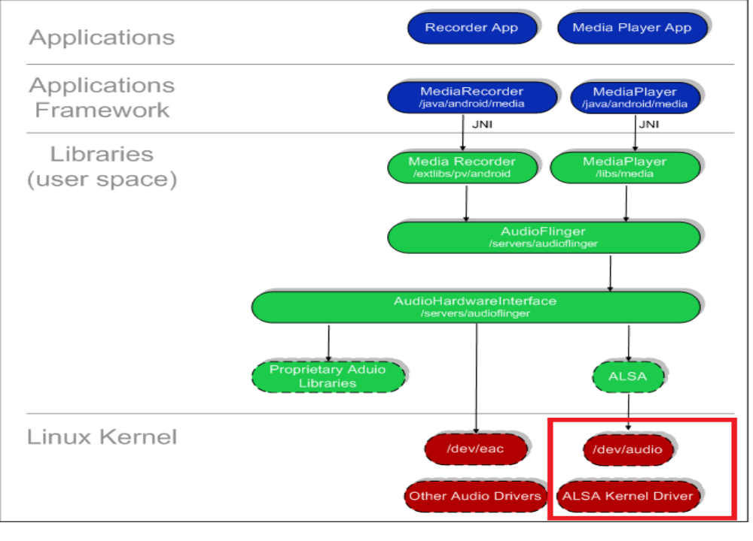
Linux kernel Audio driver(ALSA)

Slide 10
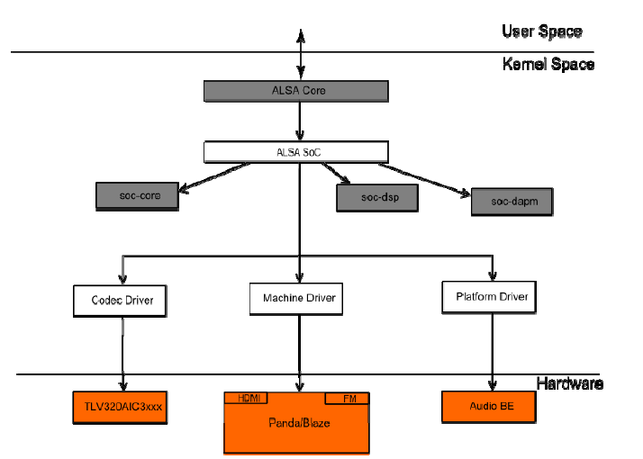
ALSA Architecture

Slide 11
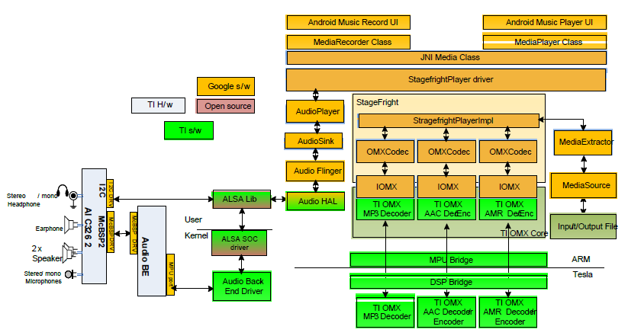
Android Audio Multimedia overview OMAP4 Example

Slide 12
Audio Framework Component
Stream: digital bits that represent a sound
–StreamVOICE_CALL (used for Voice record)
–StreamSYSTEM (for system sounds)
–StreamRING
–StreamMUSIC
–StreamALARM
–StreamNOTIFICATION
• Audio Flinger: mixer (mix sound, adjust soft volumes, …): take several streams, mix them + apply volume on each stream. These streams are entering (IN’s stream) or outputing(OUT’sstream).
• OUT’s& IN’s are physical HW channels
•These OUT’s& IN’s are attached to devices.
•Device= headset, handset, …
•Logical Streamsthat needs to be mixed are grouped into strategy
•Strategy:
–Phone: VOICE_CALL, BT_SCO
–Sonification: RING, NOTIFICATION, ALARM
–ENFORCE_ENABLED: unmutablestrings (exple: in some country it is mandatory to produce a sound when recording with a camera )

Slide 13
DATA FLOW DIAGRAMS

Slide 14
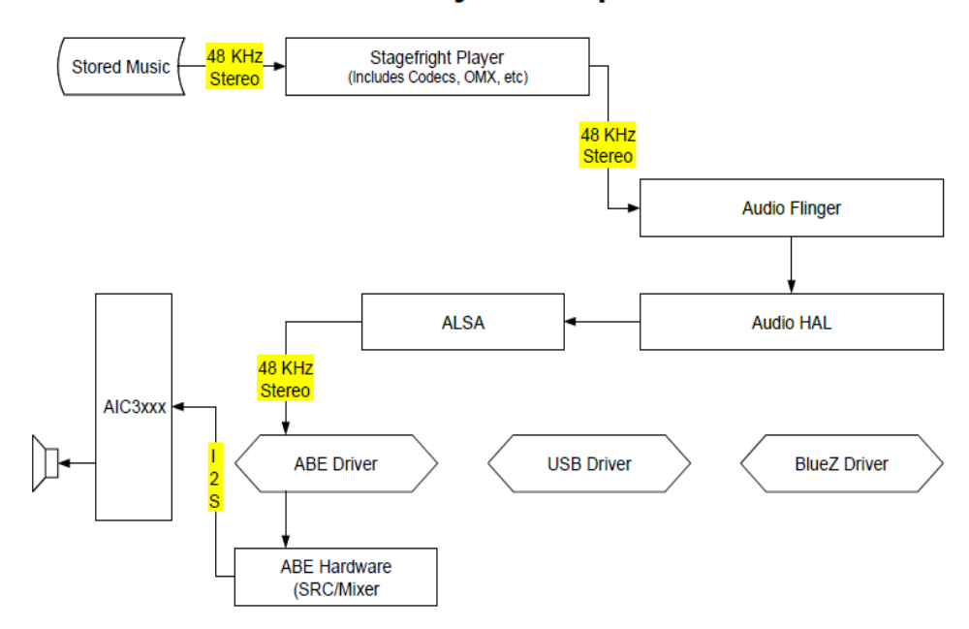
Music Play to Speaker

Slide 15
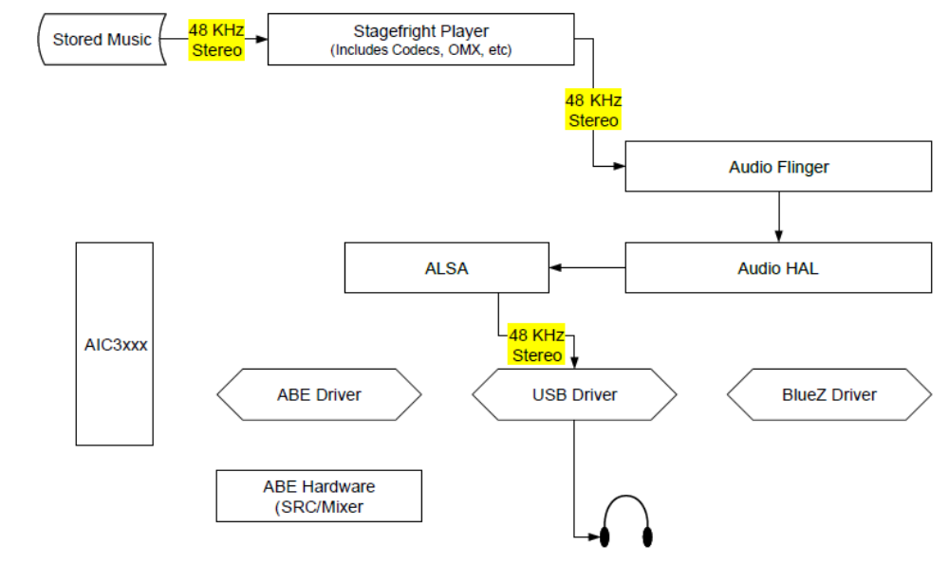
Music play to USB headphone

Slide 16
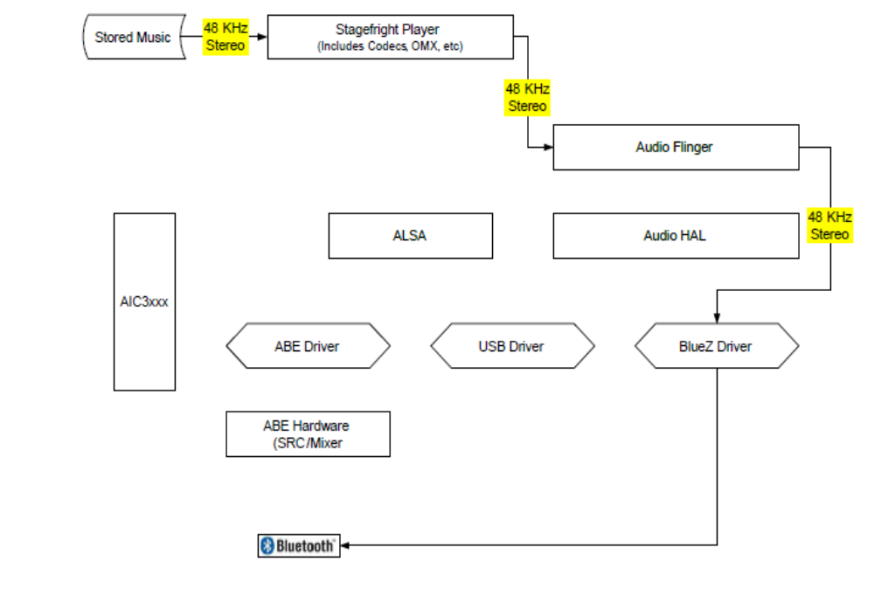
Music play to A2DP Bluetooth

Slide 17
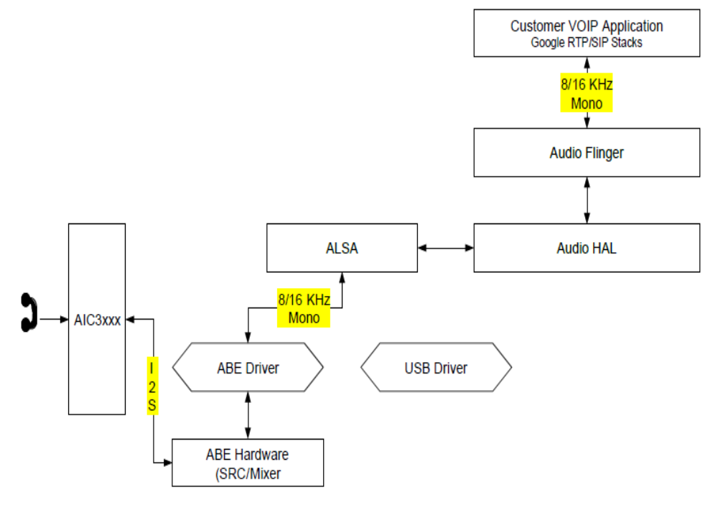
VOIP Call Data Flow

Slide 18
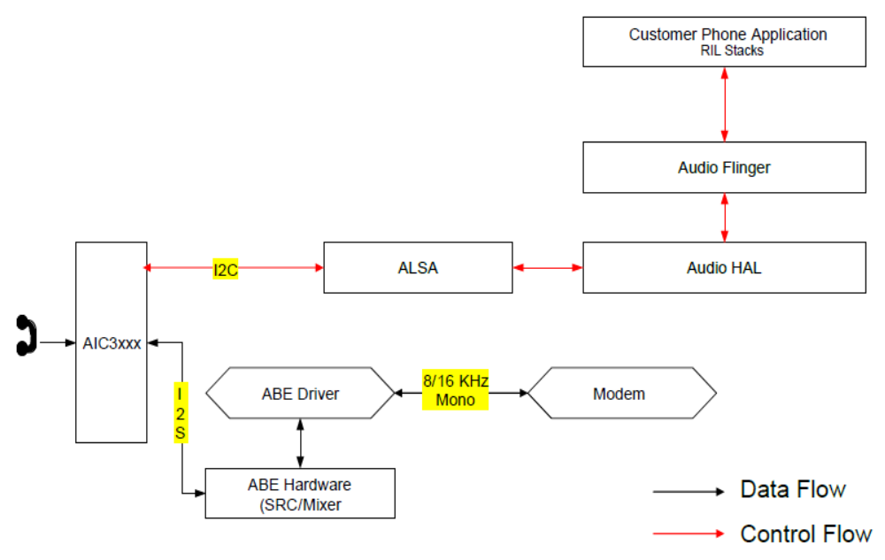
Telephony Call Flow

Slide 19
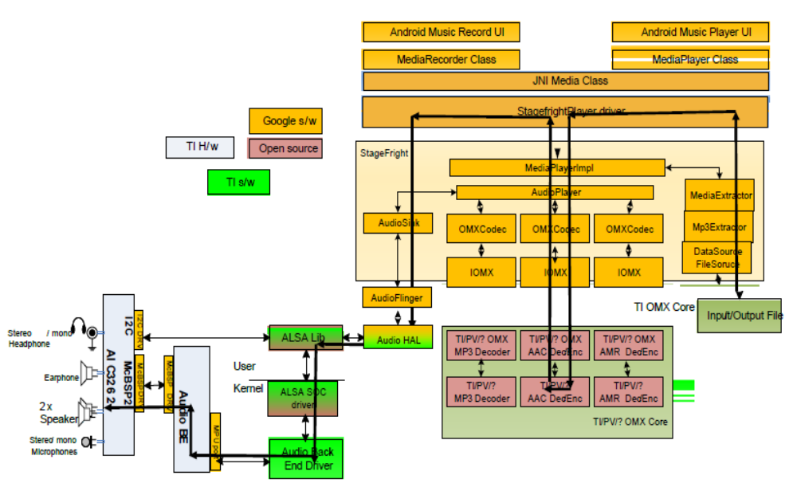
Audio Playback Data Flow

Slide 20
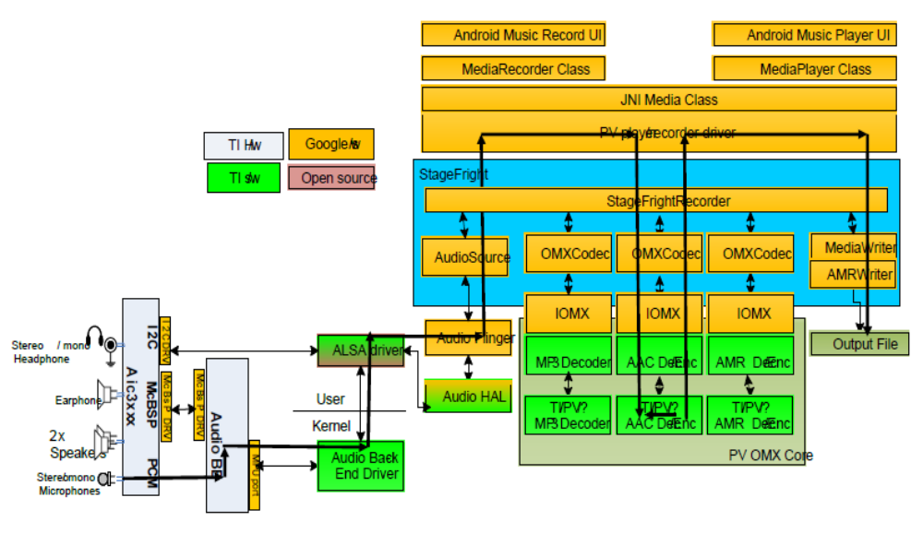
Android Record Data Flow

Slide 21
Android Audio Evolution
Ginger Bread to ICS

Slide 22
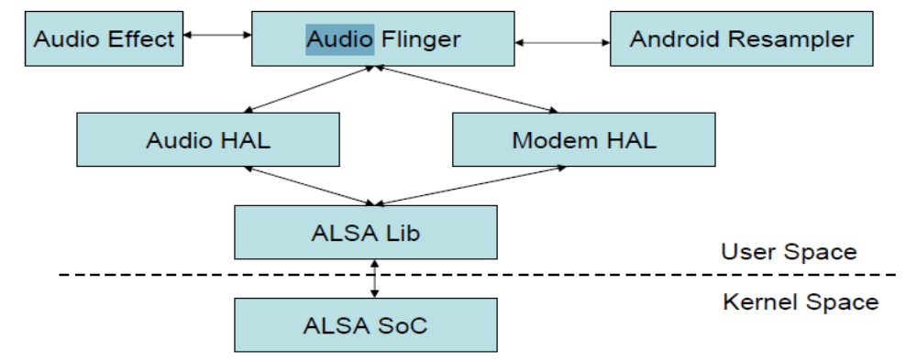
AudioSubsystem in GB
•Audio Effect library support was minimal
•Audio HAL is was C++ based
•Heavy weight ALSA Lib to interface between Userspaceand Kernel space

Slide 23
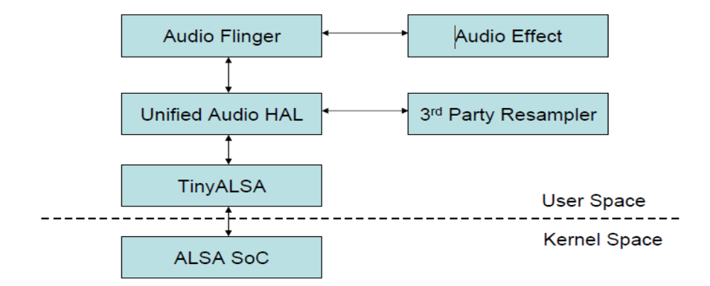
Android Audio Subsystem in ICS
•Audio Effect library to add effects to audio streams
–AEC, NC, Equalizer, agc, virtualizer, reverb
•Audio HAL is redesigned from C++ based to C based
•ALSA Lib replaced with TinyALSA

Slide 24
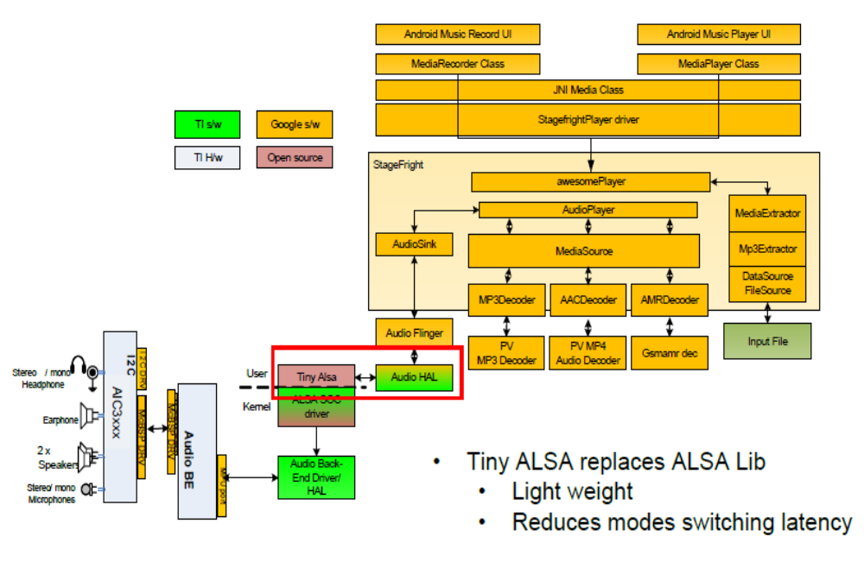
Android Audio Stack in ICS

Slide 25
Advanced Linux Sound Architecture (ALSA) Driver

Slide 26
Agenda
• ALSA driver introduction
• Platform driver
• Codec driver
• Machine driver

Slide 27
ALSA driver Introduction
• The Advanced Linux Sound Architecture (ALSA) provides audio and MIDI functionality to the Linux operating system.
• Goal is to provide efficient support for all types of audio interfaces, from consumer sound cards to professional multichannel audio interfaces
• It has both user code and kernel code. User space library (alsa-lib) to simplify application programming and provide higher level functionality.

Slide 28
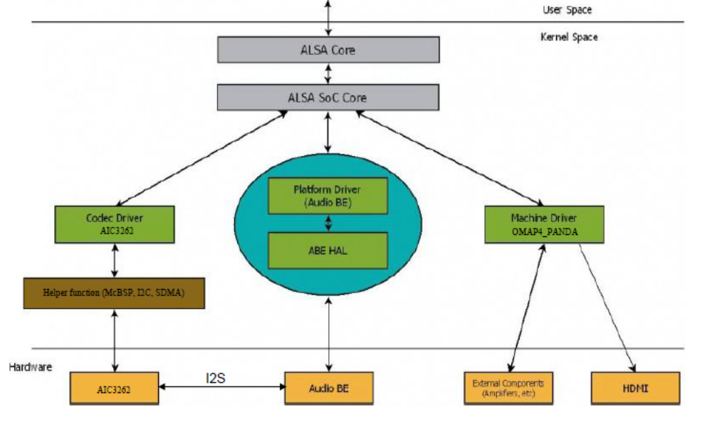
ALSA Kernel Space Architecture OMAP4

Slide 29
Platform Driver

Slide 30
Platform Driver
• An ASoC platform driver is partitioned into audio DMA, SoC DAI configuration and control. The platform drivers only target the SoC CPU and must have no board specific code.
• Omap4 contains two platform driver
1 . PCM driver: PCM interface for front end dai’s (omap-pcm.c)
2. AESS driver: ABE controls and widgets are defined in this driver
(omap-abe-dsp.c).
• FE DAI: Followings are FE DAI defined in platform driver (defined in omap-abe.c)
1. MultiMedia1
2. MultiMedia2
3. VoiceoTones
4. Vibra
5. Modem
6. MultiMedia1 LP
• BE DAI: Followings are BE DAI defined for McBSP (defined in omap-mcbsp.c),
omap-mcbsp-dai.0 (McBSP1), omap-mcbsp-dai.1 (McBSP2), omap-mcbsp-dai.2 (McBSP3)

Slide 31
Platform Driver
•Platform drivers:
=================
1. omap-pcm.c (pcm driver)
2. omap-abe-core.c (AESS driver –-ABE controls and widgets )
3. BE Dai (omap-mcbsp.c )
4. FE Dai (omap-mcpdm.c)

Slide 32
Codec Driver

Slide 33
Codec driver
•The codec driver is generic and hardware independent code that configures the codec to provide audio capture and playback. It should contain no code that is specific to the target platform or machine.
• Each codec driver must provide the following features:-
o1) Codec DAI and PCM configuration
o2) Codec control IO -using I2C, 3 Wire(SPI) or both APIs
o3) Mixers and audio controls
o4) Codec audio operations
• Optionally, codec drivers can also provide:
o5) DAPM description.
o6) DAPM event handler.
o7) DAC Digital mute control.
• AIC3262 AIC audio driver implementation is available at sound/soc/codec/tlv320aic3xxx.c. (sound/soc/codec/twl6040.c)

Slide 34
Codec driver and board files
• AIC3262 Codec driver path: sound/soc/codecs/tlv320aic3xxx.c
Master clock freq: 32.84 MHz
Sampling rates : 8K to 192 Khz
Formats: 8,16,20, 24 and 32 bits
Aic3xxx sampling rate: 44.1Kh
Important structures:
================
1. struct snd_soc_codec_driver
2. struct snd_soc_dai_driver
3. struct snd_soc_dai_ops
Board files:
---------------
1. arch/arm/mach-omap2/board4430-sdp.c

Slide 35
Codec driver
• adb commands(when dealing with the hardware)
=======================================
============
1. ./adb root
2. ./adb shell
3. adb push alsa-amixer /system/bin
4. adb pull <filename> <dest>
5. alsa-amixer controls (audio command)
//To start adb server...
./adb kill-server
./adb start-server
./adb devices

Slide 36
Codec driver
• adb commands
=============
============
1. ./adb root
2. ./adb shell
3. adb push alsa-amixer /system/bin
4. alsa-amixer controls
Displays all existing controls which are available on that platform
//To start adb server...
./adb kill-server
./adb start-server
./adb devices

Slide 37
Codec driver
Playback:
=========
alsa-amixer cset numid=108 1(Right input mixer in1-r switch)
alsa-amixer cset numid=113 1 (l switch)
alsa-amixer cset numid=120 1
alsa-amixer cset numid=116 1
alsa-amixer cset numid=30 70
alsa-amixer cset numid=77 1
alsa-amixer cset numid=106 0
alsa-amixer cset numid=107 0
Before playing a song from command prompt, we need to set the above mixer controls in kernel
MFD:
====
Drivers/mfd/tlv320aic3xxx_irq.c (twl6040-irq.c)
Drivers/mfd/tlv320aic3xxx_core.c ()twl-6040-core.c)
Header files
-----------------
Include/linux/mfd/tlv320aic3xxx-registers.h
Include/linux/mfd/core.h

Slide 38
Codec driver
Record:
------------
Mic-PGA-Vol ctl = 30
1. ./alsa-amixer cset name=”Right Input mixer IN1_R Switch” 1
2. ./alsa-amixer cset name=”Right Input mixer IN1_L Switch” 1
3. ./alsa-amixer cset name=”Left Input mixer IN1_L Switch” 1
4. ./alsa-amixer cset name=”Left Input mixer IN1_R Switch” 1
5. ./alsa-amixer cset name=”L&R_MicPGA_Vol_Ctrl” 70
6. ./alsa-amixer cset name=”Mic_Bias_Power_Ctrl” 1
7../alsa-amixer cset name=”Right ADC Route” 1
8. ./alsa-amixer cset name=”Left ADC Route” 1
Before recording: from the command prompt we need to set the above mixer controls

Slide 39
Codec driver
Name based mode and configuration: (number based mode and conf)
Tinymix 109 0 ------> 0 (mode) 0 (configuration)
Tinymix 109 1 ------> 0 1
Tinymix 109 2 ------> 0 2
Tinymix 109 256 ------> 1 0
Tinymix 109 257 ------> 1 1
Tinymix 109 258 ------> 1 2
Tinymix 109 512 ------> 2 0
Tinymix 109 768 ------> 3 0
Tinymix 109 1024 ------> 4 0

Slide 40
Codec driver
Name based mode and configuration:
Tinymix “FIRMWARE-SET-MODE” “Playback”
Tinymix “FIRMWARE-SET-MODE” “Recording”
Tinymix “FIRMWARE-SET-MODE” “Call”
Tinymix “FIRMWARE-SET-MODE” “Voipfig
1. makefile
2. Kconfig
3. include proper header files or use #include statement for not duplicating the header files
4. Then build the kernel
5. fix any run time issues if any

Slide 41
Handling mini DSP interrupts
1. cfw_ops.c
cfw_ops.h
2. aic3262_codec_ops.c
3. tlv320aic3262.c (twl6040.c or tlv320aic32x4.c)
1 and 2 files are invoked from 3 (codec driver) file
1 is for unpickling/untaring the .cfw file
2 is for pushing .cfw file (firmware) file in vendor/firmware/file.cfw
3. .cfw is generated by the client using DSP algorithms

Slide 42
Machine Driver

Slide 43
Machine Driver
• The ASoC machine (or board) driver is the code that glues together the platform and codec drivers.
• The machine driver can contain codec and platform specific code.
• It registers sound card (struct snd_soc_card) to the audio subsystem with the kernel as a platform device.
• DAI link (struct snd_soc_dai_link) is a member of sound card, which links FE DAI, platform driver and/or BE DAI, codec DAI and codec driver.

Slide 44
Machine Driver
• driver path: sound/soc/omap/sdp44xx-aic32xx.c
• driver path: sound/soc/omap/omap-abe-twl6040.c

Slide 45
Agenda for Topics
ALSA deep-dive
•Introduction (Recap)
–Audio Control Flow (eq?, headset detect?, FM radio?)
•Initialization of Audio Codec from ALSA
•Tracing events and messaging interface for playback/record/suspend/resume etc.
•DAPM (Dynamic Audio Power Management)
•miniDSPAIC driver design considerations and support

Slide 46
Thank You

